Slide 1
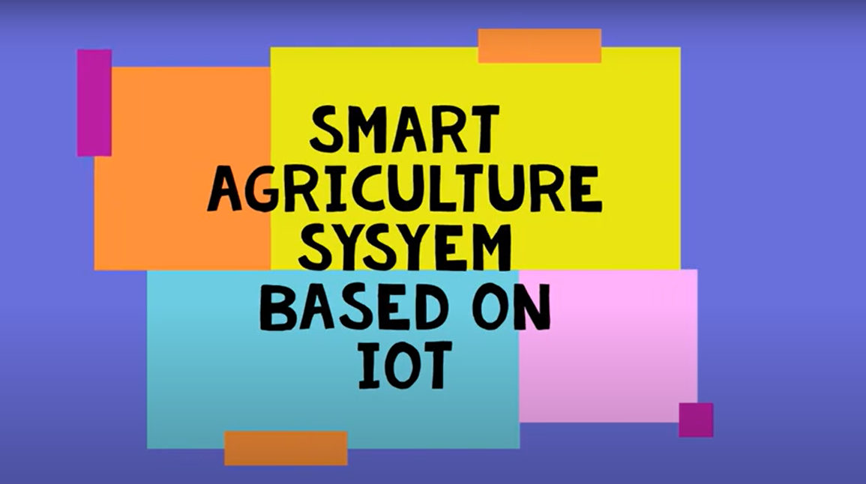

Slide 2
Existing Problem :
Many trips have to be taken in order to manually check the soil humidity on a regular basis. It can be difficult to know the exact amount of water to give plants, thus causing stress for the crops by over or under watering
Manually measuring key data points about crops is often difficult, time-consuming, and more likely to be inaccurate.
Proposed solution:
The central idea of our project is to develop a smart agriculture device which can monitor the temperature, soil moisture of the crop. This collected data is being continuously sent to cloud. The farmer can also get the real time weather forecasting data. Farmer can monitor the temperature, humidity and soil moisture parameters along with weather forecasting details through a web page. Based on all the parameters he can water his crop through the web page. Even if the farmer is not present near his crop he can water his crop remotely.

Slide 3
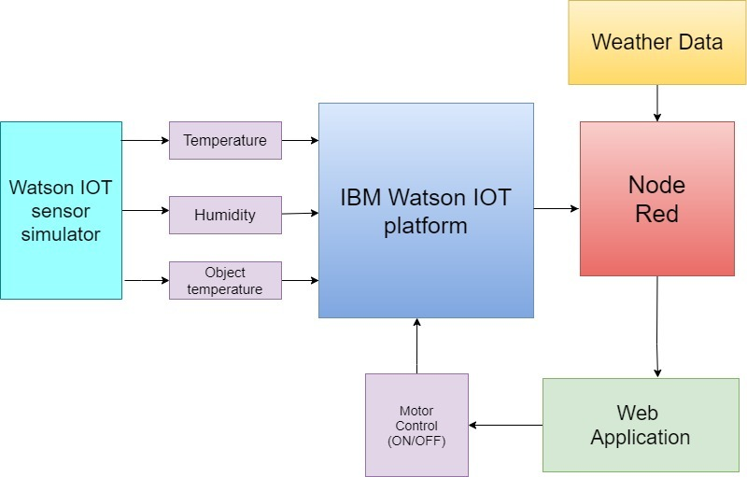
BLOCK DIAGRAM

Slide 4
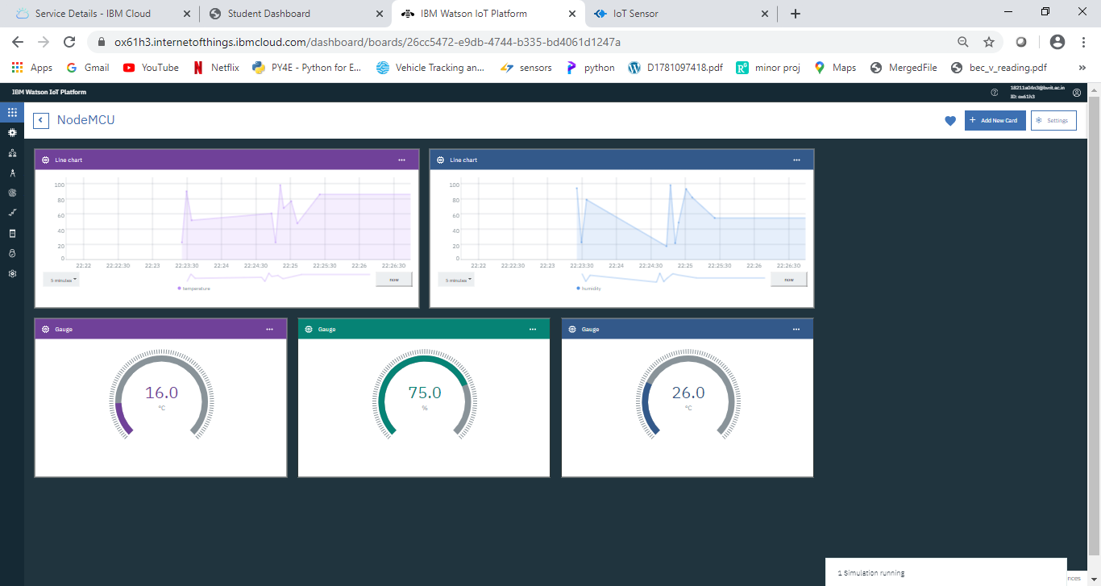
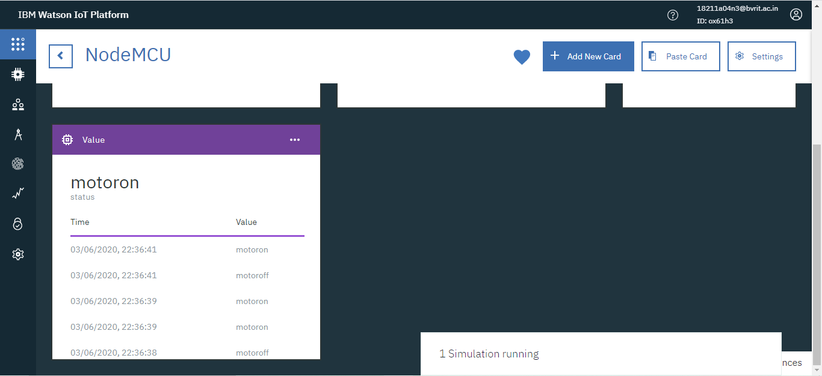
IBM IOT CLOUD PLATFORM

Slide 5
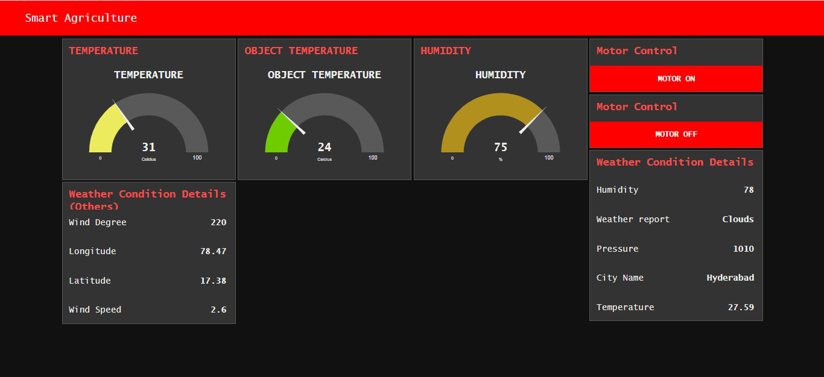
FINAL UI

